Slide 1


Contractual Verification of Web Service Compositions with Time Constraints
Enrique Martínez López
Escuela Superior de Ingeniería Informática
Departamento de Sistemas Informáticos
Universidad de Castilla-La Mancha
Campus universitario, s/n.
02071- Albacete (SPAIN)
Email: emartinez@dsi.uclm.es
Supervisors:
Dr. María Emilia Cambronero Piqueras
Dr. Gregorio Díaz Descalzo

Slide 2


CONTENTS
Introduction
Design and Verification of Web Service Compositions
Contract-Oriented Diagrams (C-O Diagrams)
Conclusions and Future Work

Slide 3
Contributions
Extension of the development of the Correct-WS methodology.
Improvement of the WST tool.
C-O Diagrams for the specification of e-contracts with time constraints
C-O Diagrams: Formal syntax, semantics, satisfaction rules and translation function to CL.

Slide 4
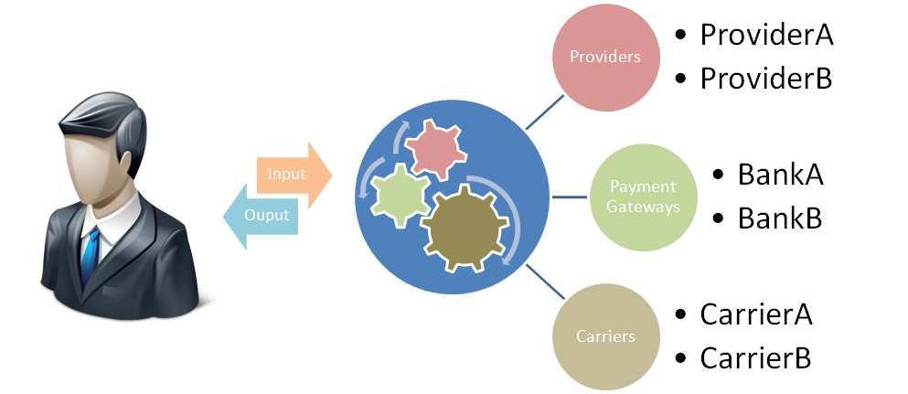
Motivation
WS-BPEL
Problem: WS-languages for composition difficult to analyze in early phases of the development process.
WS-CDL
WS-BPEL
WS-BPEL
Solution: methodology for the generation and formal Verification of “correct” WS compositions, including time constraints.

Slide 5


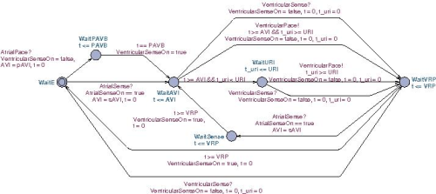


Motivation
Problem: Gap between legal contract in natural language and formal specification of electronic contract.
Electronic
Contract
Legal Contract
Solution: Graphical representation of deontic e-contracts (high level) with formal semantics for the translation into a formal language.

Slide 6
CONTENTS
Introduction
Design and Verification of Web Service Compositions
Contract-Oriented Diagrams (C-O Diagrams)
Conclusions and Future Work

Slide 7
Correct Web Services Methodology (Correct-WS)
Design and implementation of correct Web services (checked for potential design errors).
It is necessary a methodology covering every phase of the life cycle.
Analysis phase.
Design phase.
Choreography implementation phase.
Verification phase.
…

Slide 8
Correct-WS Translations
Analysis
KAOS
1
Design
Sequence Diagrams
RT-UML
XMI
2
Choreography
Implementation
4
Verification
of Design
3
Choreography Layer
WS-CDL
XML
Orchestration Layer
WS-BPEL
XML
TIMED AUTOMATA
XML UPPAAL
document
6
5
Verification of
Orchestration
Implementation
Verification of Choreography Implementation

Slide 9
Analysis Phase KAOS Methodology
Analysis
KAOS
1
Design
Sequence Diagrams
RT-UML
XMI
2
Choreography
Implementation
4
Verification
of Design
3
Choreography Layer
WS-CDL
XML
Orchestration Layer
WS-BPEL
XML
TIMED AUTOMATA
XML UPPAAL
document
6
5
Verification of
Orchestration
Implementation
Verification of Choreography Implementation

Slide 10
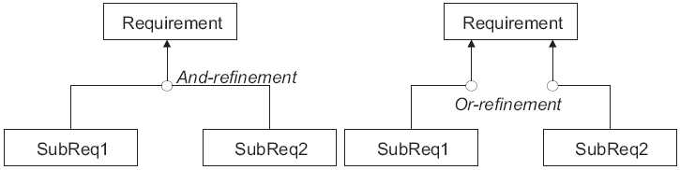
Analysis Phase KAOS Methodology
Construction of a Goal Model (properties the system must fulfill).
Structure of an AND/OR graph (specifically the one proposed by the KAOS Methodology).

Slide 11
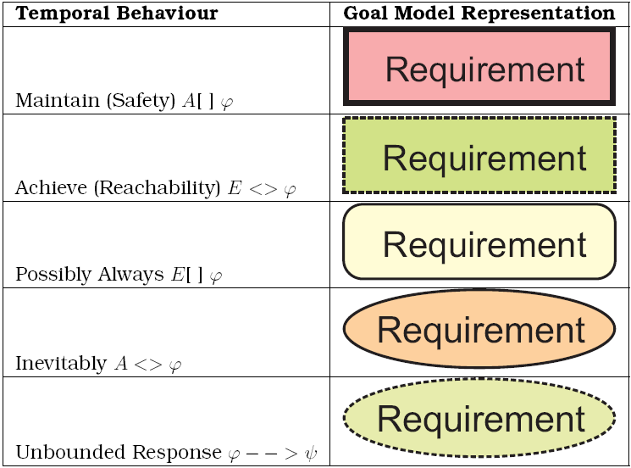
Analysis Phase KAOS Methodology

Slide 12
Correct-WS Translations
Analysis
KAOS
1
Design
Sequence Diagrams
RT-UML
XMI
2
Choreography
Implementation
4
Verification
of Design
3
Choreography Layer
WS-CDL
XML
Orchestration Layer
WS-BPEL
XML
TIMED AUTOMATA
XML UPPAAL
document
6
5
Verification of
Orchestration
Implementation
Verification of Choreography Implementation

Slide 13
Design Phase UML 2.0 Sequence Diagrams*
Analysis
KAOS
1
Design
Sequence Diagrams
RT-UML
XMI
2
Choreography
Implementation
4
Verification
of Design
3
Choreography Layer
WS-CDL
XML
Orchestration Layer
WS-BPEL
XML
TIMED AUTOMATA
XML UPPAAL
document
6
5
Verification of
Orchestration
Implementation
Verification of Choreography Implementation
* Design and Generation of Web Services Choreographies with Time Constraints (2011),
in Journal of Universal Computer Science.

Slide 14
Design Phase UML 2.0 Sequence Diagrams
Description of the system in order to capture each particular behaviour (including time-outs).
We use a UML 2.0 Sequence Diagram extended with frames.
Alt-labelled frames (if-then-else control structure).
Opt-labelled frames (if-then control structure).
Loop-labelled frames (repetitive behaviour).
Par-labelled frames (parallel activities).

Slide 15
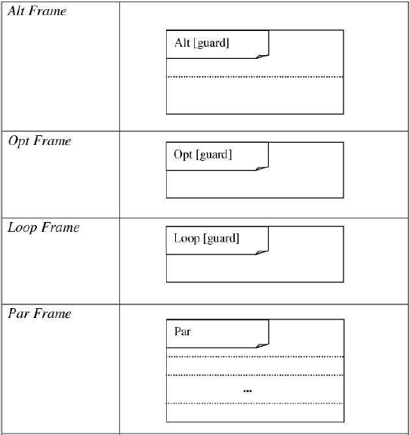
Design Phase UML 2.0 Sequence Diagrams

Slide 16
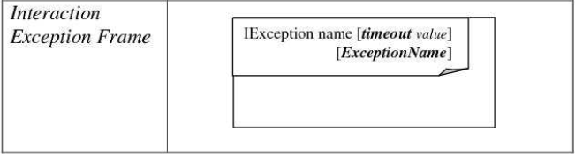
Design Phase UML 2.0 Sequence Diagrams
Interaction Exception frames (fault conditions)

Slide 17
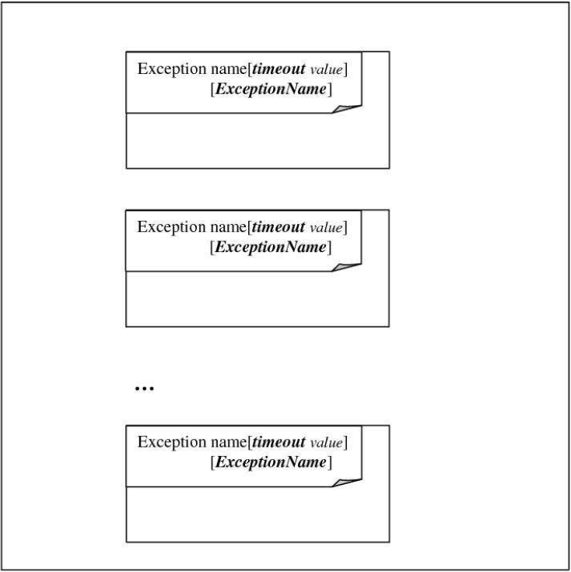
Design Phase UML 2.0 Sequence Diagrams
Exception frames (treatment of faults)

Slide 18
Correct-WS Translations
Analysis
KAOS
1
Design
Sequence Diagrams
RT-UML
XMI
2
Choreography
Implementation
4
Verification
of Design
3
Choreography Layer
WS-CDL
XML
Orchestration Layer
WS-BPEL
XML
TIMED AUTOMATA
XML UPPAAL
document
6
5
Verification of
Orchestration
Implementation
Verification of Choreography Implementation

Slide 19
Translation of UML 2.0 Sequence Diagrams into WS-CDL
Analysis
KAOS
1
Design
Sequence Diagrams
RT-UML
XMI
2
Choreography
Implementation
4
Verification
of Design
3
Choreography Layer
WS-CDL
XML
Orchestration Layer
WS-BPEL
XML
TIMED AUTOMATA
XML UPPAAL
document
6
5
Verification of
Orchestration
Implementation
Verification of Choreography Implementation

Slide 20
Translation of UML 2.0 Sequence Diagrams into WS-CDL
UML Diagrams Components | WS-CDL Components
Object | Role | Participant Type
Messages | Relationship Type | Channels Types | Interaction
Labels and Time Constrains | Time Variables | Information types | Expressions

Slide 21
Translation of UML 2.0 Sequence Diagrams into WS-CDL
UML Diagrams Components | WS-CDL Components
Timeout | - The time-out line is added to the associated interaction: <interaction name="iname" <exchange name="NCname" … </exchange> <timeout time-to-complete="XPath-expression" </interaction> - And a new workunit in the exceptionBlock: <exceptionBlock name="handleException"> … <workunit name="timeout_name" guard="cdl:hasExceptionOccurred(xsd:timeout) "> Activity </workunit> … </exceptionBlock>

Slide 22
Translation of UML 2.0 Sequence Diagrams into WS-CDL
UML Components | Frame Type | WS-CDL
Frames | “alt” label | choice
 | “opt” label | workunit
 | “loop” label | workunit
 | “par” label | parallel

Slide 23
Translation of UML 2.0 Sequence Diagrams into WS-CDL
UML Components | Frame Type | WS-CDL
Frames | “IException” label | - New exchange is added to the corresponding interaction: <exchange name="NCname" action="respond" faultName="ExceptionName"> <send variable="ExceptionName" causeException="ExceptionName" /> <receive variable="ExceptionName" causeException="ExceptionName" /> </exchange> - And a new workunit in the exceptionBlock: <exceptionBlock name="handleException"> … <workunit name="ncname" guard="cdl:hasExceptionOccurred(xsd:ExceptionName) "> Activity </workunit> … </exceptionBlock>

Slide 24
Correct-WS Translations
Analysis
KAOS
1
Design
Sequence Diagrams
RT-UML
XMI
2
Choreography
Implementation
4
Verification
of Design
3
Choreography Layer
WS-CDL
XML
Orchestration Layer
WS-BPEL
XML
TIMED AUTOMATA
XML UPPAAL
document
6
5
Verification of
Orchestration
Implementation
Verification of Choreography Implementation

Slide 25
Translation of WS-CDL documents into Timed Automata*
Analysis
KAOS
1
Design
Sequence Diagrams
RT-UML
XMI
2
Choreography
Implementation
4
Verification
of Design
3
Choreography Layer
WS-CDL
XML
Orchestration Layer
WS-BPEL
XML
TIMED AUTOMATA
XML UPPAAL
document
6
5
Verification of
Orchestration
Implementation
Verification of Choreography Implementation
* Validation and Verification of Web Services Choreographies by Using Timed Automata
(2011), in Journal of Logic and Algebraic Programming.

Slide 26
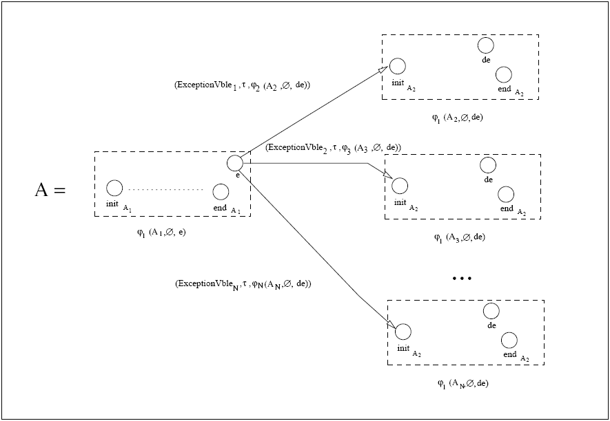
Translation of WS-CDL documents into Timed Automata

Slide 27
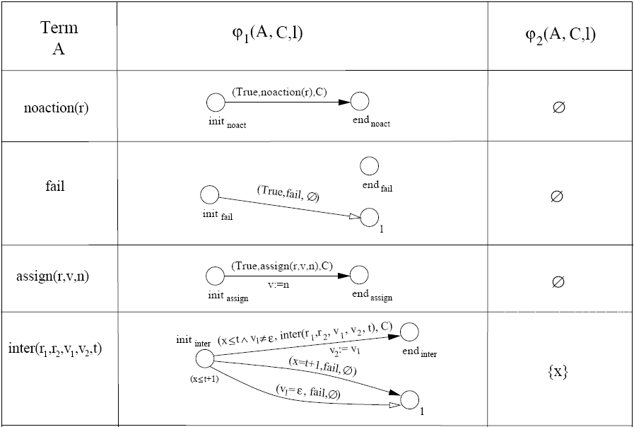
Translation of WS-CDL documents into Timed Automata

Slide 28
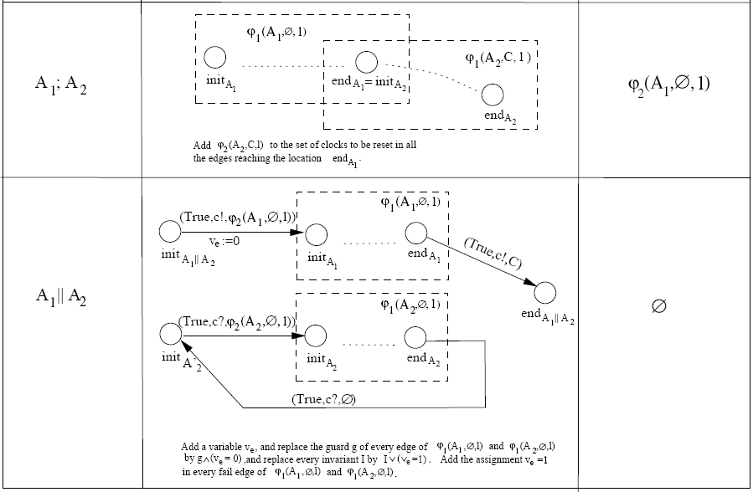
Translation of WS-CDL documents into Timed Automata

Slide 29
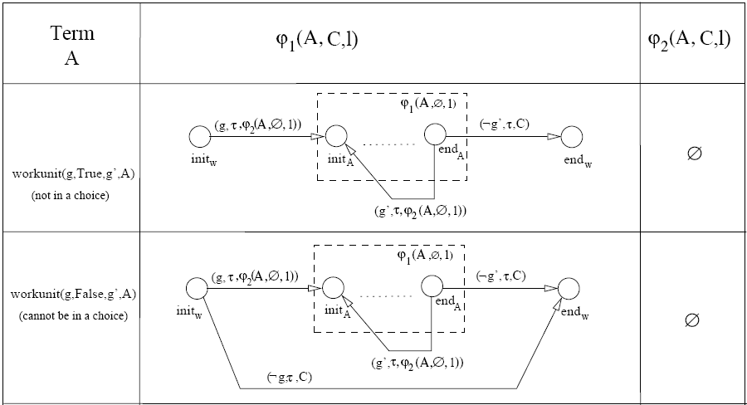
Translation of WS-CDL documents into Timed Automata

Slide 30
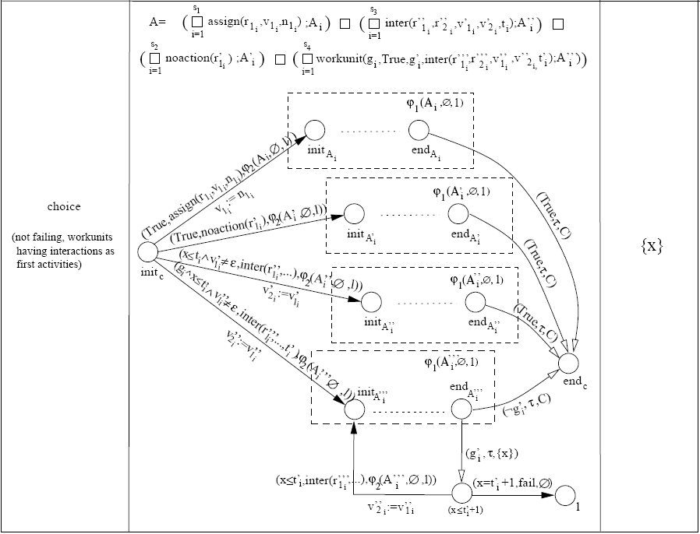
Translation of WS-CDL documents into Timed Automata

Slide 31
Web Services Translation Tool (WST)*
Integrated environment for:
The creation of UML 2.0 sequence diagrams.
The translation of the sequence diagrams into WS-CDL documents.
The translation of WS-CDL documents into Timed Automata.
XSLT Stylesheets are used to do the transformations between the different XML documents.
The resulting Timed Automata description is supported by the UPPAAL Tool (Validation and Verification).
*WST: A Tool Supporting Timed Composite Web Services Model Transformation (2010), in SIMULATION: Transactions of the Society for Modeling and Simulation International.

Slide 32
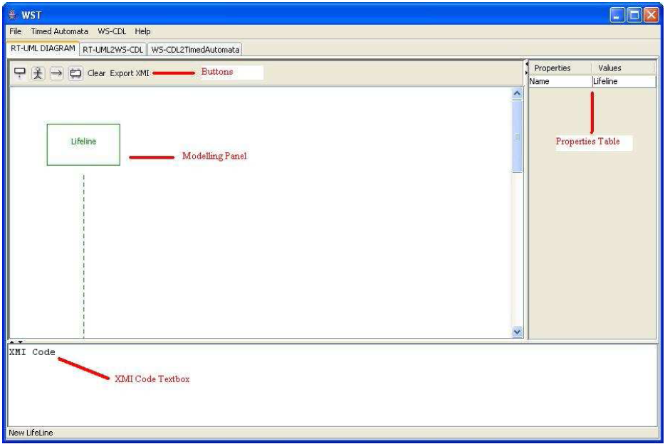
UML 2.0 Sequence Diagram Editor

Slide 33
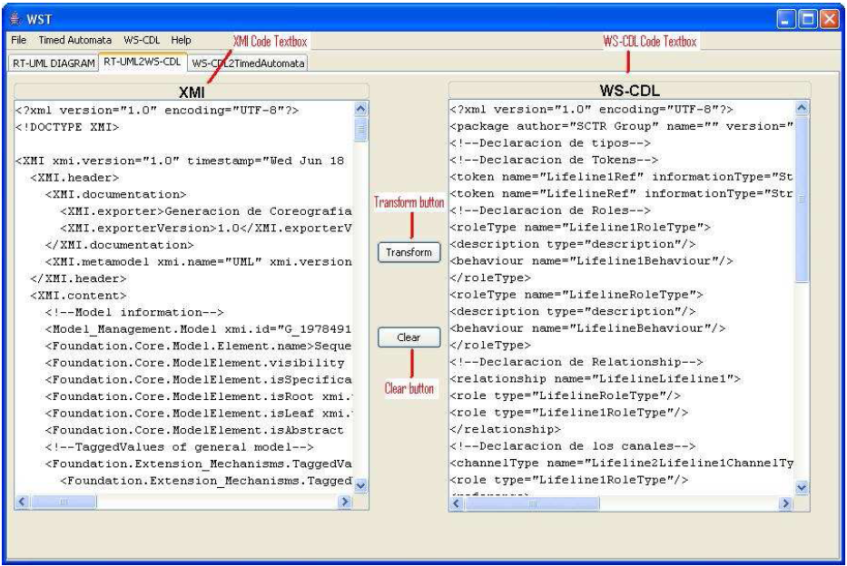
XMI to WS-CDL Translator

Slide 34
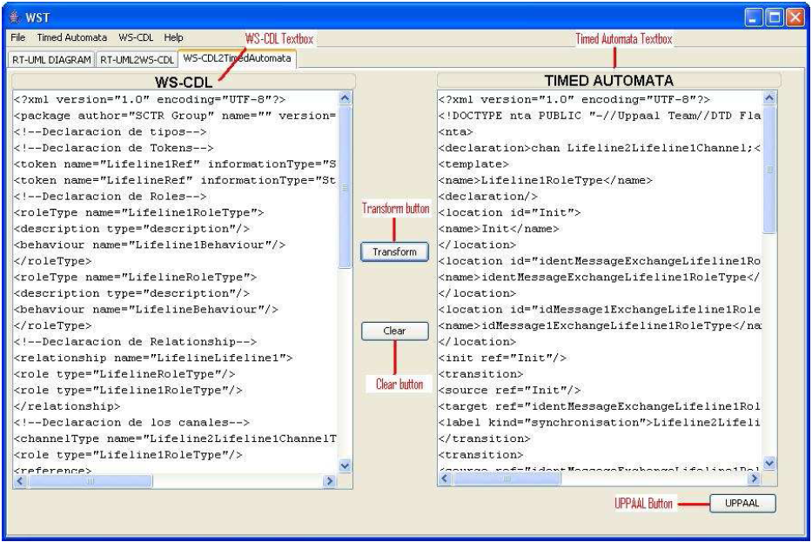
WS-CDL to Timed Automata Translator

Slide 35
Case Study: Internet Purchase Process
Three participants involved: A client, a supplier and a deliverer.
Client: contacts the supplier (product information and payment data), 48 hours to receive the product after payment, otherwise refund.
Supplier: receives the order and payment data, ack to the client (unless out of stock) and contacts a deliverer if correct payment.
Deliverer: picks up the order (with client information) and delivers the product to the client.

Slide 36
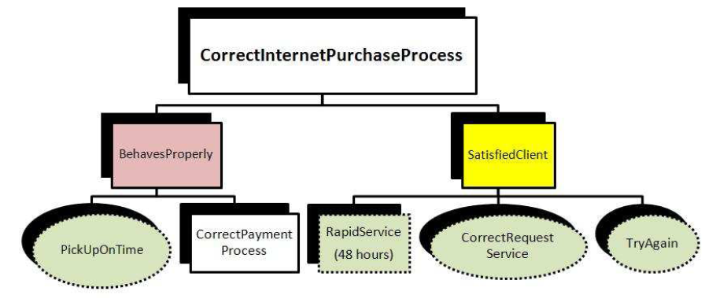
Case Study: Internet Purchase Process
Analysis Phase

Slide 37
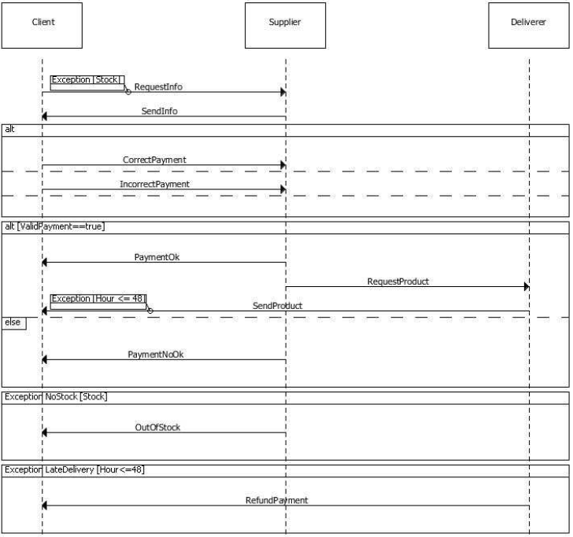
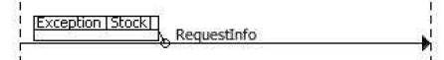
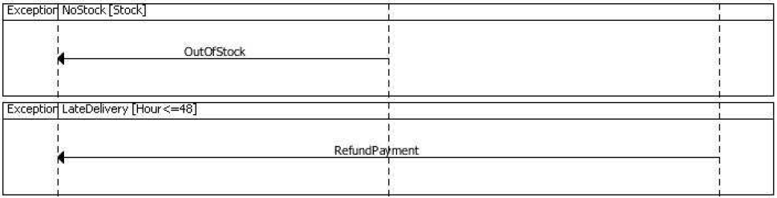

Slide 38
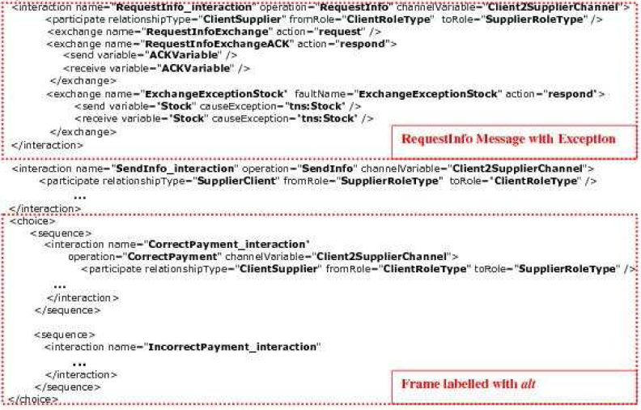

Slide 39
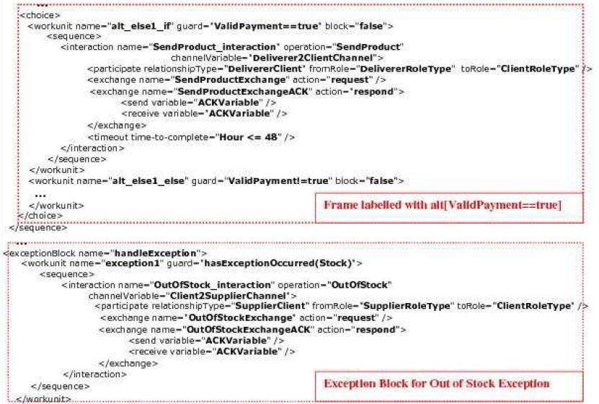

Slide 40
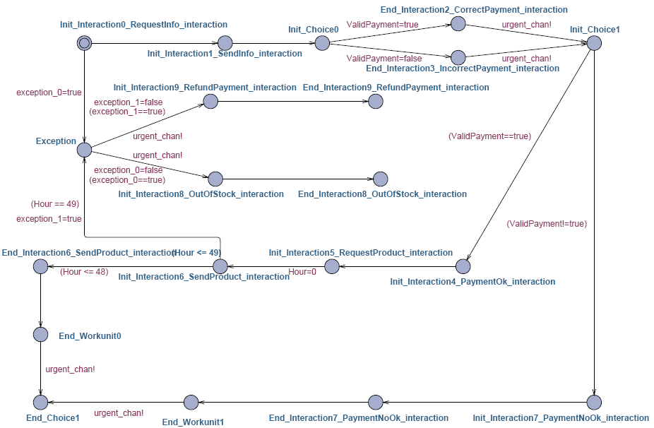

Slide 41
Case Study: Internet Purchase Process
Verification of Choreography Implementation Phase
Satisfied

Slide 42
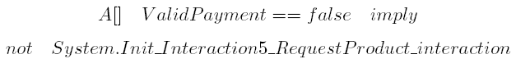
Case Study: Internet Purchase Process
Verification of Choreography Implementation Phase
Satisfied

Slide 43
Case Study: Internet Purchase Process
Verification of Choreography Implementation Phase
Satisfied

Slide 44
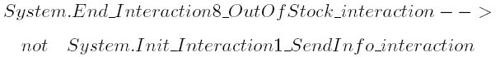
Case Study: Internet Purchase Process
Verification of Choreography Implementation Phase
Satisfied

Slide 45
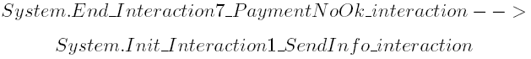
Case Study: Internet Purchase Process
Verification of Choreography Implementation Phase
Not Satisfied

Slide 46
Case Study: Internet Purchase Process
Verification of Choreography Implementation Phase
Error in the design has been found -> Back to design phase to solve the problem.
Solution: loop-labelled frame wrapping all the payment process (repetition until correct payment).
Translations and verification of properties are performed again after the modification of the diagram.
All properties are satisfied -> System “correct” with respect to the properties verified.

Slide 47
Wrap in a “loop” frame

Slide 48
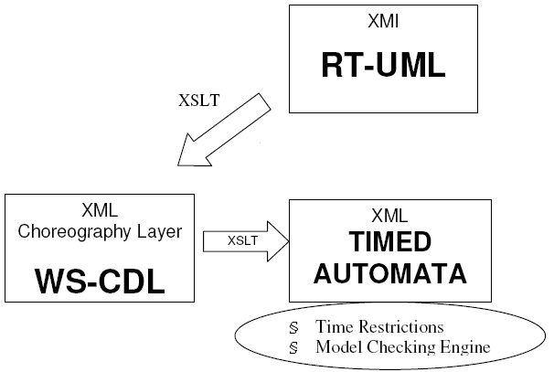
Other Phases of the Correct-WS Methodology
Phases automated by the WST Tool:
KAOS editor and generator of queries developed.
Sequence Diagram simulator also developed.
Other phases covered by several parallel works.
Dec, 2011 (Albacete)

Slide 49
CONTENTS
Introduction
Design and Verification of Web Service Compositions
Contract-Oriented Diagrams (C-O Diagrams)
Conclusions and Future Work

Slide 50
Description*
The graphical representation consists of a hierarchical tree diagram that we call Contract-Oriented Diagram (C-O Diagram for short).
In the nodes of these diagrams we specify obligations (O), permissions (P) and prohibitions (F) over actions to model the contract clauses.
It is possible to define reparations to compensate the violation of obligations or prohibitions.
The nodes can include conditions and real-time constraints affecting the contract clauses.
*A Model for Visual Specification of e-Contracts (2010), in The 7th IEEE International
Conference on Services Computing (SCC 2010).

Slide 51
Description
Coffee Machine Example:
“The coffee machine is obliged to deliver coffee after payment in less than one minute”.
“The client is permitted to choose the option coffee with milk”.
“The client is forbidden to pay with coins different from Euros”.
“The coffee machine is obliged to deliver milk after delivering coffee if coffee with milk has been chosen.
“The coffee machine is obliged to refund money if coffee is not deliver”.

Slide 52
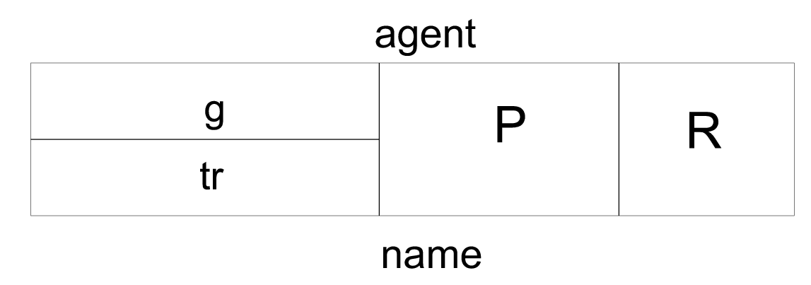
Description
g is used for the conditions.
tr is used for real-time constraints.
P is the proposition that must be satisfied (O/P/F over an action).
R is the reference to the reparation contract.
agent is the party affected by the clause.
name is just used to name the clause.

Slide 53
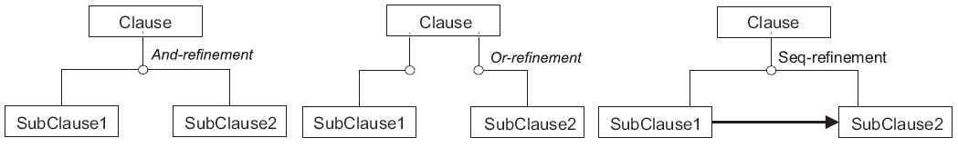
Description
Nodes can be refined hierarchically by means of three different refinements: AND/OR/SEQ.
Obligations, permissions or prohibitions specified in a node affect all its subnodes (one per branch).
Composition of actions through the different refinement (only atomic actions in leaf nodes).
Composition of O/P/F also by means of the different refinements.

Slide 54
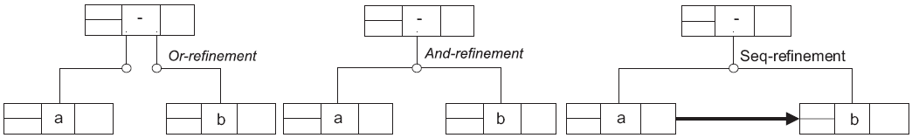
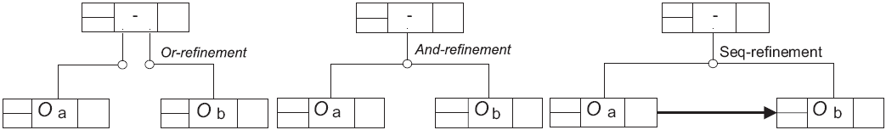
Description
Composition of actions:
Composition of obligations:

Slide 55
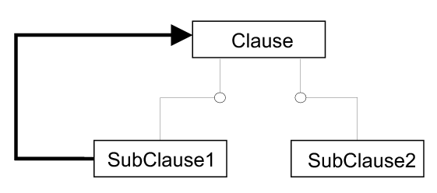
Description
The agent is only specified in the nodes where obligations, permissions or prohibitions are defined.
The reparation R is only allowed in nodes defining an obligation or a prohibition.
Another structure can be used to model repetition:

Slide 56
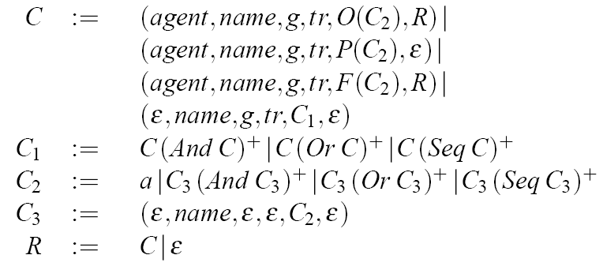
Syntax
C denotes a contract modelled by a C-O Diagram.
Contract defined by the following EBNF grammar:

Slide 57
Semantics
Transformation into a Network of Timed Automata (NTA).
Additional definition of two orderings depending on the violation and satisfaction of clauses: ≺_{N} (Ordering on nodes) and ≺_{E} (Ordering on edges).
Three sets are defined for each node: V(n) (violation set), S(n) (satisfaction set) and P(n) (permission set).
Graphically, the three sets are drawn under each node between braces ({V} {S} {P}).

Slide 58
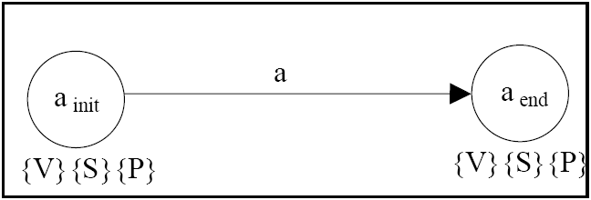
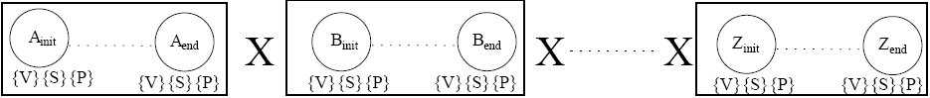
Transformation Rules
Atomic action:
Composition of actions with AND-Refinement:
Cartesian Product

Slide 59
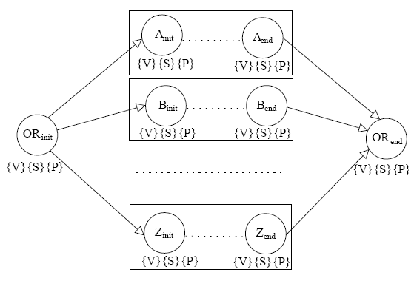
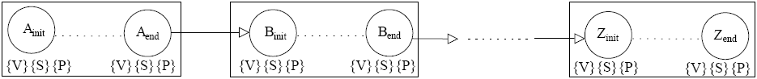
Transformation Rules
Composition of actions with OR-Refinement:
Composition of actions with SEQ-Refinement:

Slide 60
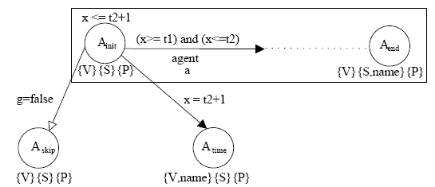
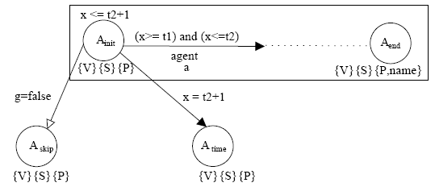
Transformation Rules
Obligation (O) over action:
Permission (P) over action:

Slide 61
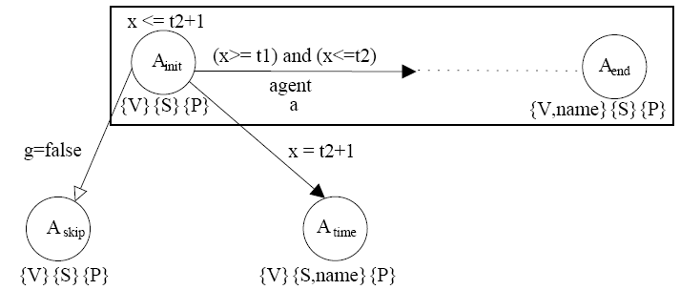
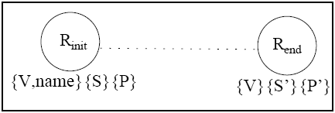
Transformation Rules
Prohibition (F) over action:
Reparation (R) of clause name:

Slide 62
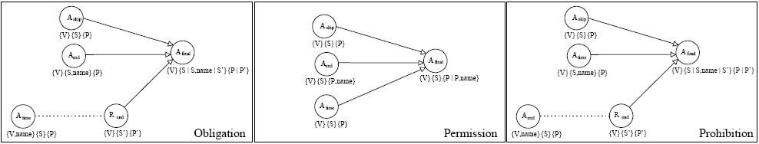
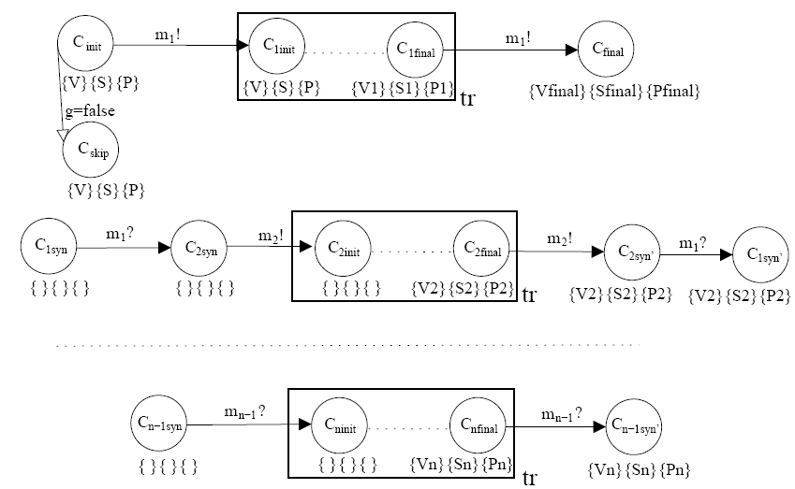
Transformation Rules
Collapsing in a single final node:
Composition of norms with AND-Refinement:

Slide 63
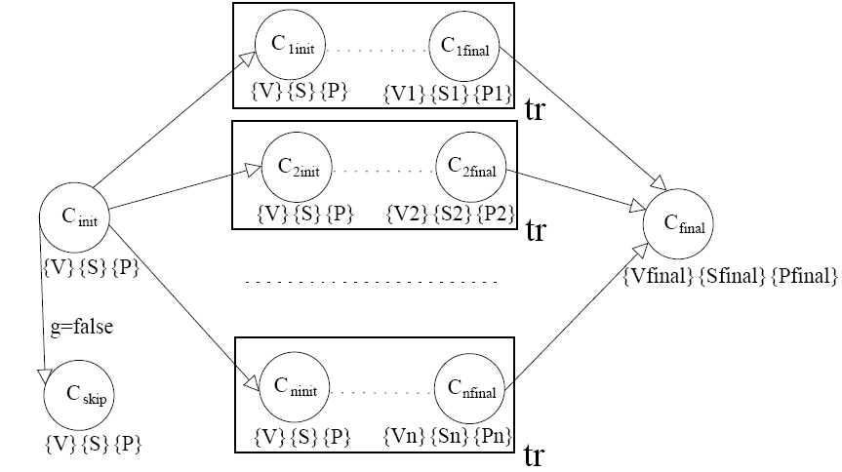
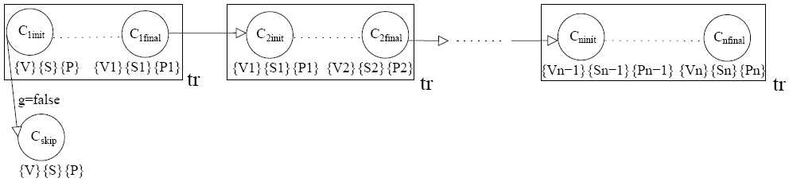
Transformation Rules
Composition of norms with OR-Refinement:
Composition of norms with SEQ-Refinement:

Slide 64
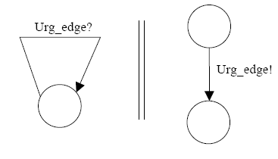
UPPAAL Implementation
The NTA obtained after translation can be implemented in UPPAAL.
Urgent edges are encoded by means of a synchronization with an urgent channel.
V(n), S(n) and P(n) are encoded as boolean arrays.

Slide 65
Case Study: Online Auctioning Process
3 agents: Buyer, Seller and Auction Service.
Seller auctions an item, Auction Service publish the auction and Buyer can place bids.
If highest bid, Buyer pays the item and, after that, Seller sends the item.
If item is not received, Auction Service refunds Buyer and can penalize Seller -> Reparation.
Real-time constraints are considered for actions and the last part depends on a condition (highest bid).

Slide 66
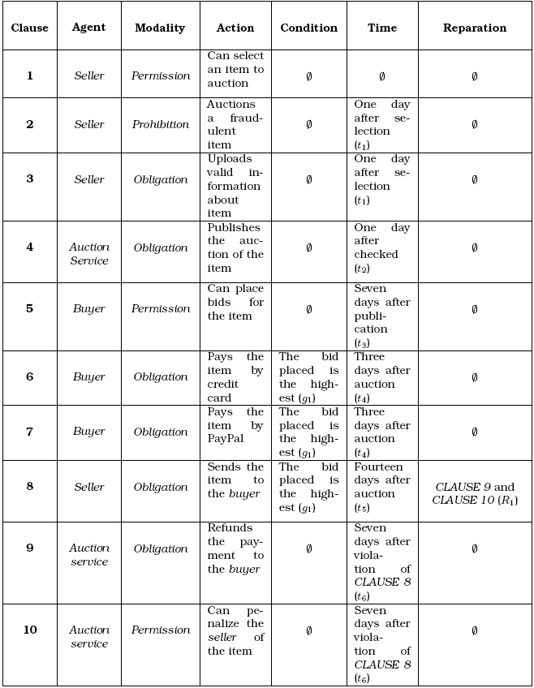
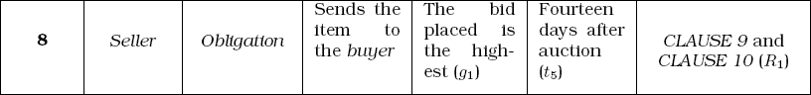
Case Study: Online Auctioning Process
Contract Clauses

Slide 67
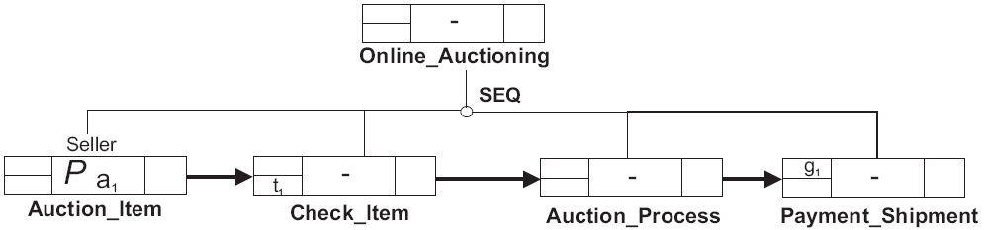
Case Study: Online Auctioning Process
C-O Diagrams
Top-level of the diagram we specify for the online auctioning process:

Slide 68
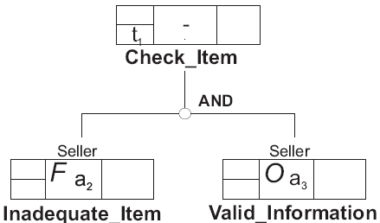
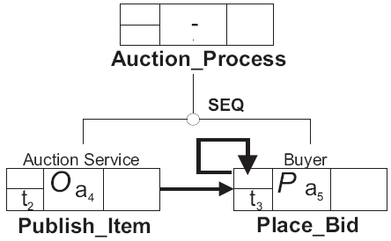
Case Study: Online Auctioning Process
Decomposition of clause Check_Item:
Decomposition of clause Auction_Process:

Slide 69


Case Study: Online Auctioning Process
Decomposition of clause Payment_Shipment:
Reparation of clause Send_Item:

Slide 70

Case Study: Online Auctioning Process
Timed Automata

Slide 71

Case Study: Online Auctioning Process

Slide 72

Case Study: Online Auctioning Process

Slide 73

Case Study: Online Auctioning Process
Validation and Verification
NTA obtained can be implemented in the UPPAAL tool for validation and verification.
Simulation to check that the contract behaves as expected.
UPPAAL
Simulator

Slide 74

Case Study: Online Auctioning Process
Verification by checking the satisfaction of properties in the UPPAAL Verifier.

Slide 75

Case Study: Online Auctioning Process
Also checking that undesirable properties are never satisfied in the UPPAAL Verifier.

Slide 76

Case Study: Online Auctioning Process
Diagnostic trace can be provided by the verifier in the simulator for an unsatisfied property.

Slide 77

Other Applications
Satisfaction Rules*
Set of rules to check whether a contract is satisfied or not by a specific timed automaton.
For example:
*Contractually Compliant Service Compositions (2011), in The Ninth International Conference
on Service Oriented Computing.

Slide 78

Other Applications
From C-O Diagrams to CL
Translation
Function

Slide 79
CONTENTS
Introduction
Design and Verification of Web Service Compositions
Contract-Oriented Diagrams (C-O Diagrams)
Conclusions and Future Work

Slide 80
Conclusions
Extension of the Correct-WS methodology (treatment of exceptions).
Improvement of the WST Tool in many aspects (seq. diag. editor, WS-CDL to T.A., integration,…).
Novel approach for the specification and verification of deontic e-contracts with time constraints.
C-O Diagrams for the graphical specification of e-contracts, definition of formal syntax and semantics.
Translation to CL contract language and satisfaction rules.

Slide 81
Conclusions
Advantages of Correct-WS methodology and WST:
Formal verification of properties in early phases.
Problems detected can be solved before implementation.
XML code is obtained automatically from a graphical model.
Advantages of C-O diagrams:
Graphical representation amenable for formal verification.
Contract can be formally verified with respect to some properties of interest.
A way to find out contradictions and unexpected behaviours allowed by the contract.

Slide 82
Future Work
Integration of other model transformations in the WST Tool (WS-CDL to Petri Nets, WS-CDL to BPEL,…).
Study of the complexity and scalability of C-O Diagrams (how complex?).
Application of C-O Diagrams to different contexts (requirements engineering, SPL families,…)
Tool to model C-O Diagrams and automatizing the translation into timed automata.
Query Language for contracts to specify properties we want to check at a higher level of abstraction.

Slide 83
Publications
Summary
3 publications in International Journals indexed by the JCR.
13 publications in International Conferences and Workshops (including 2 publications in Core A Conferences).
1 publication in a National Conference (Concurrent and Distributed systems).

Slide 84
Research Stays
Department of Applied IT at Chalmers/University of Gothenburg, Sweden for 3 months in 2009.

Slide 85
Contractual Verification of Web Service Compositions with Time Constraints
Enrique Martínez López
Escuela Superior de Ingeniería Informática
Departamento de Sistemas Informáticos
Universidad de Castilla-La Mancha
Campus universitario, s/n.
02071- Albacete (SPAIN)
Email: emartinez@dsi.uclm.es
Supervisors:
Dr. María Emilia Cambronero Piqueras
Dr. Gregorio Díaz Descalzo

Slide 86
Publications
Journal Papers
Cambronero, M.E., Díaz, G., Martínez, E., Valero, V. and Tobarra, L. (2010). WST: A Tool Supporting Timed Composite Web Services Model Transformation, SIMULATION: Transactions of the Society for Modeling and Simulation International.
Cambronero, M.E., Díaz, G., Valero, V. and Martínez, E. (2011). Validation and Verification of Web Services Choreographies by Using Timed Automata, Journal of Logic and Algebraic Programming.
Cambronero, M.E., Valero, V. and Martínez, E. (2011).Design and Generation of Web Services Choreographies with Time Constraints, Journal of Universal Computer Science.

Slide 87
Publications
International Conference Papers
Cambronero, M.E., Díaz, G., Valero, V. and Martínez, E. (2008). A Tool for the Design and Verification of Composite Web Services, in Second International Workshop on Formal Languages and Analysis of Contract-Oriented Software.
Martínez, E., Díaz, G., Cambronero, M.E. and Valero, V. (2009). Design and Verification of Web Services Compositions, in The Fourth International Conference on Internet and Web Applications and Services.
Valero, V., Macia, H. and Martínez, E.(2009). Transforming WS-CDL specifications into Coloured Petri Nets, in International Workshop on Petri Nets and Software Engineering (PNSE09).

Slide 88
Publications
Martínez, E., Díaz, G., Martínez, C.R., Cambronero, M.E. and Valero, V. (2009). Time Ordering Architecture in SCA, in TAMoCo 2009 Techniques and Applications for Mobile Commerce.
Cambronero, M.E., Díaz, G., Martínez, E. and Valero, V. (2009). A comparative study between WSCI, WS-CDL, and OWL-S, in The 2009 IEEE International Conference on e-Business Engineering (ICEBE 2009).
Andrés, C., Díaz, G., Martínez, E. and Zhang, Y (2009). Formal Study of Prioritized Service Compositions, in International conference on signal-image technology & internet based systems, 5th (SITIS 2009).
Mateo, J.A., Díaz, G., Martínez, E. and Cambronero, M.E. (2010). Modeling Conference Contribution Management Using Web Services, in The Fifth International Conference on Internet and Web Applications and Services.

Slide 89
Publications
Martínez, E., Díaz, G., Cambronero, M.E. and Schneider, G. (2010). A Model for Visual Specification of e-Contracts, in The 7th IEEE International Conference on Services Computing (SCC 2010).
Martínez, E. and Schneider, G. (2010). Automated Analysis of Conflicts in Software Product Lines, in 1st International Workshop on Formal Methods in Software Product Lines Engineering.
Martínez, E., Díaz G. and Cambronero, M.E. (2010). Visual Specification of Formal e-Contracts, in Fourth Workshop on Formal Languages and Analysis of Contract-Oriented Software.
Mateo, J.A., Valero, V., Martínez, E. and Díaz, G. (2011). Analysis and Verification of Web Services Resource Framework (WSRF) specifications Using Timed Automata Modeling Conference Contribution Management Using Web Services, in The Sixth International Conference on Internet and Web Applications and Services.

Slide 90
Publications
Martínez, E., Cambronero, M.E., Díaz, G. and Schneider, G. (2011). Timed Automata Semantics for Visual e-Contracts, in Fifth Workshop on Formal Languages and Analysis of Contract-Oriented Software.
Martínez, E., Díaz, G. and Cambronero, M.E. (2011). Contractually Compliant Service Compositions, in The Ninth International Conference on Service Oriented Computing.
Valero, V., Macia, H. and Martínez, E.(2009). A Petri Net Semantics for WSCDL, in XVII Jornadas de Concurrencia y Sistemas Distribuidos.
National Conference Papers

